Slide 1
Powering up your Python web applications
Allyn Hunt
Blog: AllynH.com
Twitter: @Allyn_H_
Web application: DestinyVaultRaider.com

Slide 2
Allyn Hunt (me)
Father.
Engineer.
Learning Python for 3 years.
Blogging about my experiences with Python, Raspberry Pi, Destiny API, Arduino.
Started DestinyVaultRaider.com as a hobby project and to learn more about Python and web development.
Notes:
I use Python for work:
Lot’s of automation projects… So many automation projects.
Created a dashboard web application with Flask.
Started learning Python as a means to play around with the Destiny API and learn web development.
Lets take a quick look at Destiny Vault Raider.
Destiny is an online first person shooter video game.
Developed by Bungie (Halo series).
Destiny 1 (September 2014).
Destiny 2 (September 2017).

Slide 3
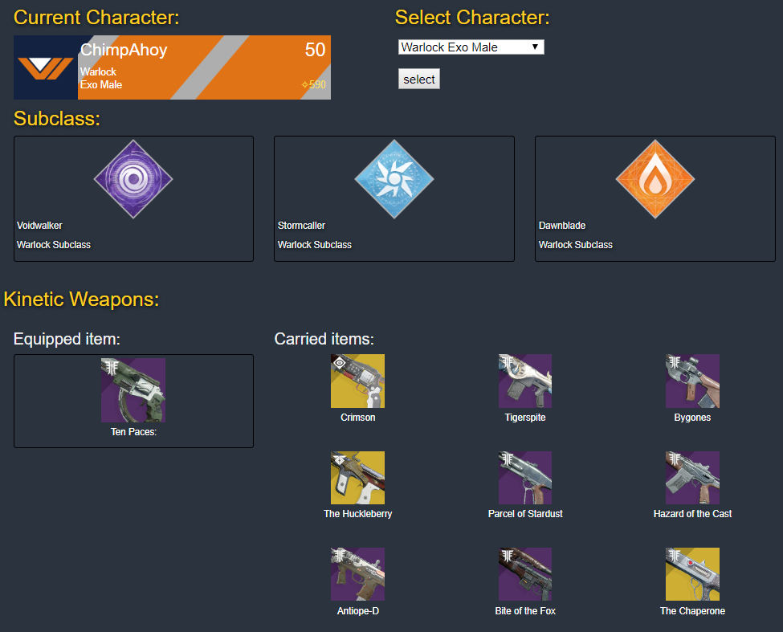
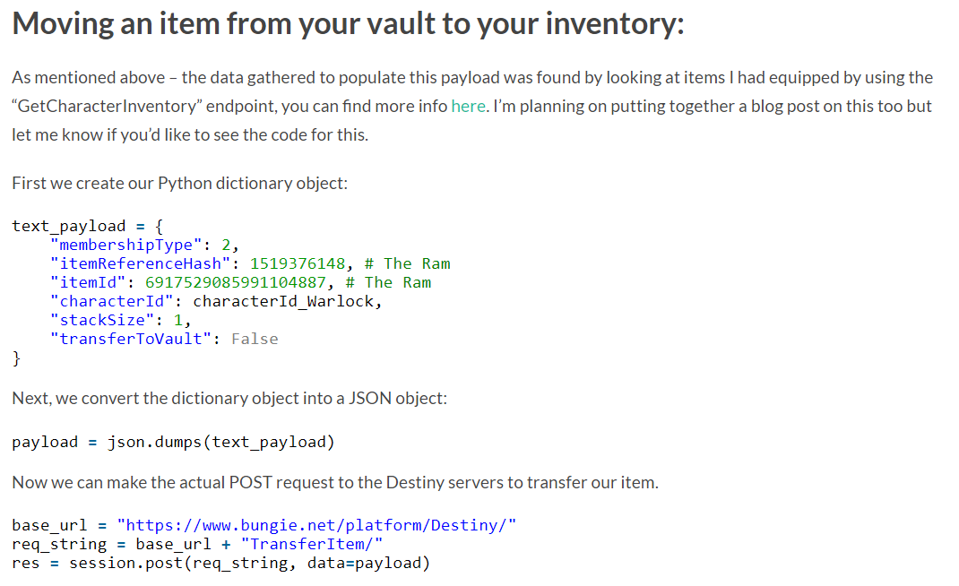
Introduction to Destiny Vault Raider:
DestinyVaultRaider app:
Blog post detailing how app was built:
Notes:
Each section of the application has a corresponding blog post.
Blog served 2 purposes:
Document my journey learning Python and Web Development.
Help out other community developers working on the Destiny API.
All of the images, weapon names, character profile information are taken from the Destiny API.
Most popular post was detailing the Destiny OAuth 2.0 flow, which as gained a lot of interest in the community.
This seems to be an area which has caught out a lot of people.
I’ve linked in with a group of community developers.
Had lots of people contact me through the blog, or mail or over Twitter.

Slide 4
Video:
Notes:
Here’s a live demo of the Destiny Vault Raider app:
Currently in vault view.
Transferring Helmet to character,
Equip it, helmet changes.
Transferring Mida-Multi tool,
Equip it, gun appears on back changes.
Transfer a sword for PvP – doesn’t appear as Mida is equipped.

Slide 5
What I am here to talk about:
App structure.
Adding asynchronous tasks with Redis and Celery.
Adding a React frontend.
Examples in Flask but portable to Django.
Notes:
This talk will focus on how to power up your Python web applications, upgrading a basic application to a modular, scalable powerhouse.
I will cover concepts that I have learned while creating my own web based applications.
With a focus on Flask, these concepts should be easily portable to other frameworks such as Django.

Slide 6
App structure:
Benefits of using the Flask application factory:
  Most documentation focuses on the “how” and not “why”.
  Why should I add more time and complexity to my app?
Flask-Script / Flask-CLI:
  Creating a manage.py script.
  Easily manage database changes.
  Python interpreter access to your databases.
Separating your app into Blueprints:
  Separate authorised / unauthorised views.
  Add API functionality.
  Look at some of the DVR API endpoints.
Notes:
There are a huge number of resources around for implementing each of these steps.
Most of guides focus on how to add functionality, not on “why” they are done this way.
It can be hard to understand these benefits upfront:
Users either ignore these features.
Or skip over them and not fully understand what they bring to your app.

Slide 7
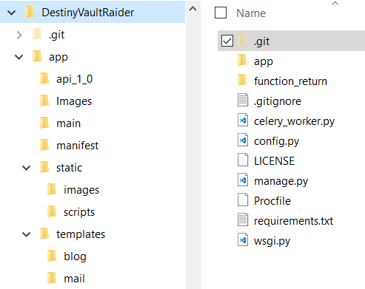
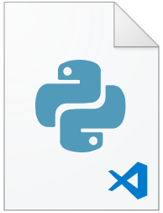
We want to move away from this:
app.py
Notes:
Just because you can build a web application in one file, doesn’t mean you should.
There are a lot of tutorials discussing how to structure your application
It can be difficult to understand why you should invest the effort in refactoring.

Slide 8
Free your database:
Avoid attaching directly to your app:
Instead, do this:
app.py (or __init__.py)
__init__.py
def create_app(config_name):
app = Flask(__name__)
app.config.from_object(config[config_name])
db = SQLAlchemy(app)
db = SQLAlchemy()
def create_app(config_name):
app = Flask(__name__)
app.config.from_object(config[config_name])
db.init_app(app)
Notes:
This is the Flask app factory:
We are defining the SQLAlchemy object globally and attaching it to the application via the init_app function.
The init_app function prepares the application to work with SQLAlchemy.
But it does not BIND the SQLAlchemy object to your application!
Why not bind the object?
We can separate the database from view context.

Slide 9
Accessing your database outside of a HTTP Request:
Development:
(venv) [AllynH_dev] C:\example_app\>python manage.py shell >>> files = Files.query.all() >>> print("Found", len(files), "files") Found 4 files >>> job_queue = Queue.query.all() >>> print("There are", len(job_queue), "queue items.") There are 4 queue items.
Production:
(venv) [AllynH_dev] C:\example_app\>set FLASK_CONFIG=production (venv) [AllynH_dev] C:\example_app\>python manage.py shell >>> files = Files.query.all() >>> print("Found", len(files), "files") Found 46716 files >>> job_queue = Queue.query.all() >>> print("There are", len(job_queue), "queue items.") There are 15 queue items.
Notes:
I’m using Flask-Script manage.py but this can be done with Flask-CLI.
By using the Flask app factory and passing the production parameter to the FLASK_CONFIG:
We can access our database outside of the web server:
We don’t need to tie our code to a request action.
We can access the production database too:
Flask SQLAlchemy handles the connection to our production PostgreSQL server.
Not accessing out local SQLite database.

Slide 10
Modify database contents outside of pgAdmin:
(venv) [AllynH_dev] C:\example_app\>python manage.py shell >>> files = Files.query.all() >>> print("Found", len(files), "files") Found 46716 files >>> job_queue = Queue.query.all() >>> print("There are", len(job_queue), "queue items.") There are 15 queue items.
>>> from datetime import datetime, timedelta >>> for q in job_queue: ... later = datetime.now() + timedelta(hours=10) ... if q.time_to_live > later: ... db.session.delete(q) ... >>> db.session.commit() >>> job_queue = Queue.query.all() >>> print("There are", len(job_queue), "queue items.") There are 7 queue items.
Notes:
Now that we have access to our production database – outside the Flask server, we can do some cool stuff.
In this situation, I had a bug in my code – more of a feature really, and needed to delete any old jobs, running with that bug.
This example could be expanded out to include database with 1-to-many relationships.
For example, each item in the “Runs” database, can have multiple items from the “Files” database linked to it.
It would be extremely difficult to do something like this manually through pgAdmin.
This is a cool feature, it allows us to reuse the Models code from our app and all of the database connections to access out database outside of the app.

Slide 11
Connecting many servers to your web app:
Notes:
The same code base can be used to connect multiple servers to a single web application.
Web server is only called via WSGI file or runserver command.
Proc file calls WSGI file, instantiates web server.
When run on local server, we reuse the code for our app models and database connections.
So what is the DB engine doing?:
DB engine is used to parse any files on local server.
Web server doesn’t have access to these servers, so ho do you get data to your application?
Pushes results to database (can be on a cloud server, DBaaS, or any of the other servers).
DB engine takes a list of files from the Queue database and parses them.
Cron job runs on server, any jobs related to a local server are executed and results are pushed
Apps running on local servers can import database models push data to the database.
Web server can read data from database tables.
Web server can write jobs to the jobs Queue database.

Slide 12
Sharing Flask models with other apps:
db_engine.py
from app import create_app, db from app.models import Users, Files, Queue # etc...: create_app('production').app_context().push()
# code to open and parse files, etc.: my_queue = Queue.query.all() For queue in my_queue: output = parse_log_file(queue.run_dir, queue.owner, queue.run_tag, queue.user_tag)
# Add runs to the Queue database.: add_run = Queue( time_to_live = datetime.utcnow() + timedelta(hours=24)) run_dir = my_file[‘RUN_DIR'], owner = my_file[‘OWNER'], site = my_file ['SITE'], host = my_file ['HOST_MACHINE'], run_tag = my_file.get('run_tag', 'Development'), user_tag = my_file.get('user_tag', ''), time_to_live = datetime.utcnow() + timedelta(hours=24)) db.session.add(add_run) db.session.commit()
Notes:
We can import our create_app function:
Import our database models.
When executing the create_app, we push the context to our app.
We are not calling app.run(), or app runserver – so we are not accessing the Request context.
You can create app’s with the Request context, for example with unit testing.
You can create a Python package (I believe there is a talk on that tomorrow)
Create a command in your manage.py or Flask CLI file.
Or you can create a separate file, in my case I used arg_parser as I wanted more control run modes.

Slide 13
Adding asynchronous tasks:
Notes:
We’ve seen how to write code to connect a local server and web server to a shared database.
If you don’t need to access data from other servers but are reliant on other long running tasks.
Pushing large input files to your app.
Executing long running tasks outside of the Request context.
Automatically having your server check for updates to some file.
Miguel Grinberg wrote a tutorial on sending asynchronous emails.

Slide 14
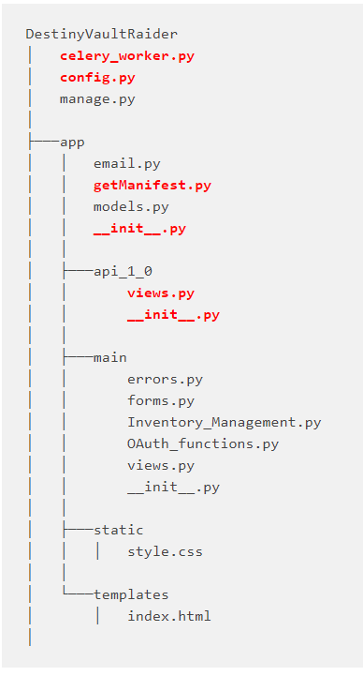
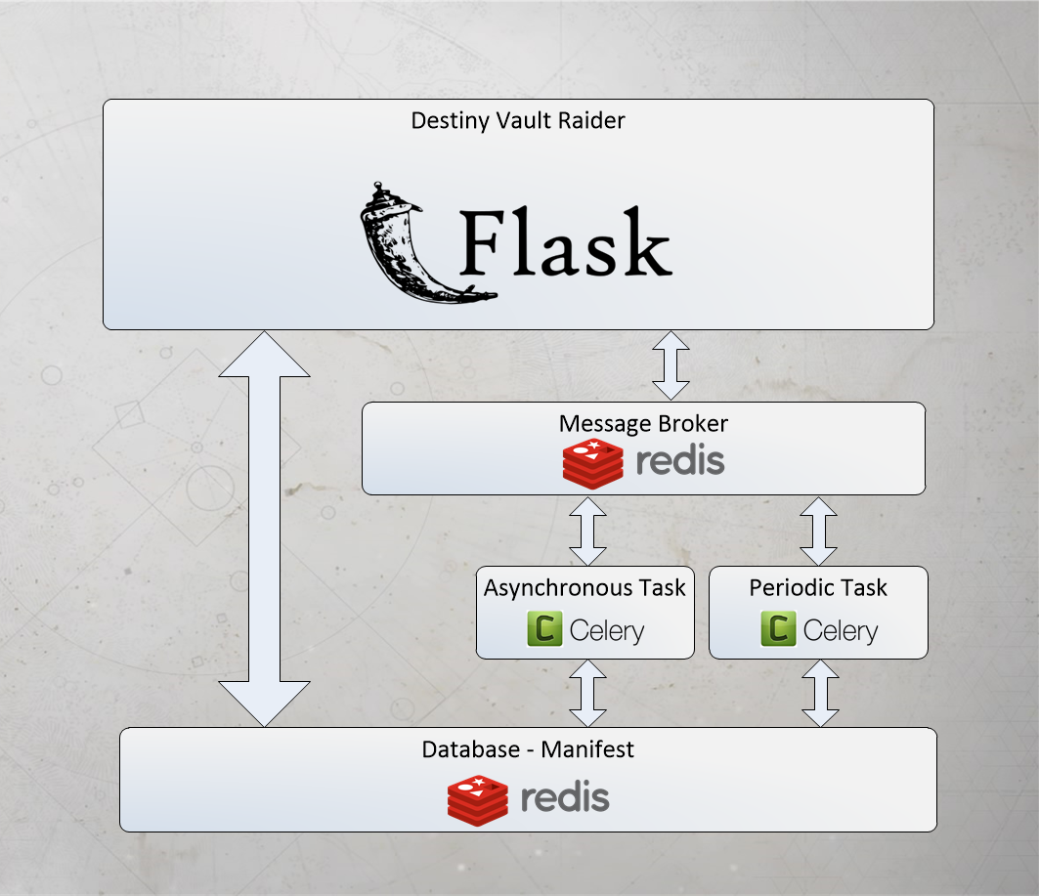
Asynchronous tasks with Celery and Redis:
Notes:
For Destiny Vault Raider, I used Redis as a database and message broker and Celery for the workers.
From the diagram, we can see:
How the Flask application connects to the Redis message broker.
The Message broker talks to the Celery worker.
The Celery worker calls (either the asynchronous or periodic) Python function to update the Redis Manifest database.
The Flask application can access the Manifest database directly, when a user makes a request to view their items.
Now, lets turn these ideas into code!
Before adding background tasks, I needed to manually update the Manifest file.
If the Manifest version stored on my production environment didn’t match the current revision of the Manifest Bungie were using, this would cause an error in my Flask application, sending the user a HTTP 500 internal error response and be diverting them to a generic error page.
This leads to a negative user experience, and with the Manifest being updated randomly – sometimes twice a week, I was left scrambling to update it as quickly as possible.
This was a huge pain point.
Before adding the background tasks, I had a small Python script running from my Raspberry Pi, which would send a request to Bungie, every 10 minutes, for the current Manifest version – if the stored Manifest version was different, the script would send me a message on a private Slack channel to notify me that the Manifest had changed and I’d need to update my Heroku environment.

Slide 15
Connect to the Redis database:
config.py
class Config: # Redis: REDIS_HOST = os.environ.get('REDIS_HOST') REDIS_PASSWORD = os.environ.get('REDIS_PASSWORD') REDIS_PORT = os.environ.get('REDIS_PORT') REDIS_URL = os.environ.get('REDIS_URL')
__init__.py
redis_url = urlparse.urlparse(Config.REDIS_URL) redis_db = redis.StrictRedis(host=redis_url.hostname, port=redis_url.port, db=1, password=redis_url.password) # Test connection: try: redis_db.ping() print("Redis is connected!") except redis.ConnectionError: print("Redis connection error!")
Notes:
In my config.py I set the Redis URL, and credentials.
Note: Redis extension does not allow the use of Flask init_app, so can’t be shared like the DB.
There are other flavours of Flask-Redis but I was limited to this one due to developing on Windows.
Flask-Redis, RQ and Flask-and-Redis can all be used.
The first thing I do is test the connection.
When my app starts, I’m looking to see “Redis is connected!”.

Slide 16
Create a Celery worker:
config.py
CELERY_BROKER_URL = os.environ.get('REDIS_URL') CELERY_RESULT_BACKEND = os.environ.get('REDIS_URL')
app/__init__.py:
celery = Celery(__name__, broker=Config.CELERY_BROKER_URL) def create_app(config_name): app = Flask(__name__) app.config.from_object(config[config_name]) config[config_name].init_app(app) celery.conf.update(app.config)
celery_worker.py
import os from app import celery, create_app app = create_app(os.getenv('FLASK_CONFIG') or 'default') app.app_context().push()
Notes:
Celery communicates via messages, using a broker to mediate between clients and workers.
First we define the Celery Broker URL.
Create an instance of the Celery class, add the Celery configuration.
Take the instance of the celery object we created and add it to the app context.
There is also an if statement, not shown, to connect to a localhost version of Redis.
So far I’ve:
I’ve connected to the Redis database.
Added Celery to the app.
Next – I create the Celery tasks.

Slide 17
Creating a periodic task:
config.py
Task name: app.getManifest.periodic_run_get_manifest
The task is located in the “app” folder.
In the “getManifest” file.
The function is called periodic_run_get_manifest.
celery_get_manifest_schedule = { 'schedule-name': { 'task': 'app.getManifest.periodic_run_get_manifest', 'schedule': timedelta(seconds=300), }, } CELERYBEAT_SCHEDULE = celery_get_manifest_schedule
app/getManifest.py
@periodic_task(run_every=timedelta(seconds=300)) def periodic_run_get_manifest(): """ Perodic task, run by Celery Beat process """ response = run_get_manifest() return response
Notes:
First, I create the setup for the Celery beat schedule, I set the schedule for 5 minutes, which is 300 seconds.
To create the periodic function, I create a new function periodic_run_get_manifest().
This function is decorated with the @periodic_task decorator. The “run_every” parameter is required and sets the time interval.

Slide 18
Executing the Periodic task:
Executing Celery Beat worker:
> worker -A celery_worker.celery --loglevel=info > celery beat -A celery_worker.celery --loglevel=info
Console output:
[2017-11-22 13:38:08,000: INFO/MainProcess] Received task: app.getManifest.periodic_run_get_manifest[97a82...5b84] [2017-11-22 13:38:08,059: INFO/Worker-1] Starting new HTTPS connection (1): www.bungie.net [2017-11-22 13:38:10,039: WARNING/Worker-1] Detected a change in version number: 60480.17.10.23.1314-2 [2017-11-22 13:38:10,042: INFO/Worker-1] Starting new HTTPS connection (1): slack.com [2017-11-22 13:38:10,803: WARNING/Worker-1] Detected a change in mobileWorldContentPaths: [u'en']
Notes:
To start the Celery workers, you need both a Celery worker and a Beat instance running in parallel. Here are the commands for running them.
This can be done on 1 line on Linux systems.
Received the task: app.getManifest.periodic_run_get_manifest()
Created a new HTTPS connection to www.bungie.net – this is the request to check the Manifest version.
Next I check the version number of the Manifest, and print the line “Detected a change in version number: 60480.17.10.23.1314-2”
Created a new HTTPS connection to www.slack.com and I send this line to Slack as a message.
Next I check the mobileWorldContentPaths version for the English Manifest, and print the line “Detected a change in mobileWorldContentPaths: [u’en’]”

Slide 19
Creating the asynchronous task:
app/getManifest.py
@celery.task(name='tasks.async_run_get_manifest') def run_get_manifest(): manifest_version = request_manifest_version() if check_manifest(manifest_version) is True: getManifest() else: print "No change detected!" return manifest_version
Task definition
Executed via private endpoint
app/api_1_0/views.py
app/getManifest.py
@api.route('/update_manifest') @login_required def update_manifest(): async_run_get_manifest() return render_template('update_manifest.html', site_details = site_details )
def async_run_get_manifest(): response = run_get_manifest.delay() return response
Notes:
Check for the manifest version.
If check_manifest is True, I get the new version of the Manifest.
Note the @celery.task decorator.
we can access the delay() method as we have wrapped the run_get_manifest() function in the @celery_task decorator.
When calling the function, I call the async_run_get_manifest via a private endpoint.
(Access granted only to my account).

Slide 20
Adding in a JS frontend:

Slide 21




Server side apps – not just for fully rendered HTML:
Delivering a JSON response:
Delivering fully rendered HTML pages:
Static HTML web page:
JSON response:
Helmets:
JSON response:
{
“itemName”: “Wing Theorem”
“itemType”: “Helmet”,
“attributes”:
[
“Legendary”,
“600”,
“item3”
]
}
Wing Theorem
Nezarec's Sin
Chest armour:
Reverie Dawn Tabard
Vesper of Radius
Notes:
Fully rendered web pages:
Can be very restrictive from a user interface standpoint.
Whenever anything changes, you need to reload the full page.
Lots of API calls and database pulls can slow this down.
jQuery integrates well with existing projects, with minimal effort.
Event listeners, modifying existing divs, modals, etc.
JSON response:
You don’t always have to send a fully rendered response.
Can be used with an AJAX call to reload parts of your application data.
Separate AJAX calls for database and API requests.
React works well when it handles rendering the content.
Great for API calls and separating dependencies.

Slide 22
Adding an API blueprint:
app/__init__.py
app/api_1_0/views.py
def create_app(config_name): # put config here: from .api_1_0 import api as api_blueprint app.register_blueprint(api_blueprint)
@api.route('/character_details', methods=['GET', 'POST']) @login_required def character_details(): user = g.user destinyMembershipId = g.user.destinyMembershipId membershipType = g.user.membershipType # Get profile information: GetProfile_res = GetProfile(destinyMembershipId, membershipType) character_details = get_character_details_dict(GetProfile_res) return jsonify(character_details)
app/api_1_0/__init__.py
from flask import Blueprint api = Blueprint('api', __name__) from . import views
Notes:
It’s a good idea to separate your HTML views from your JSON data endpoints.
Here we register the API_1_0 Blueprint, in the create app function.
In the API folder, we create an instance of the Blueprint.
We can then add any data endpoints in the views.py
There’s a lot going on in the background of “/character_details” but we’ll look into some of the JSON on the following slides.

Slide 23
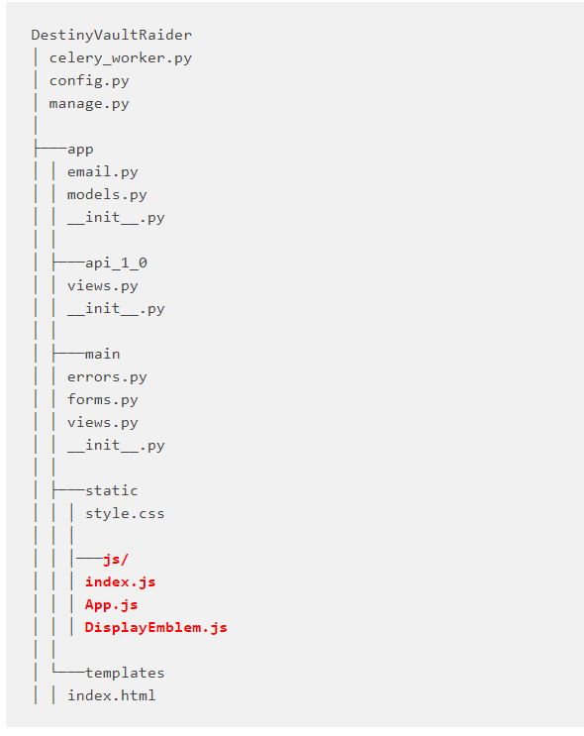
Installing React:
> cd Destiny_Vault_Raider/app/static > npm init # Install Webpack: > npm i webpack --save-dev # Install Babel: > npm i babel-core babel-loader babel-preset-es2015 babel-preset-react --save-dev # Install React: > npm i react react-dom --save-dev
base.html
<script src="{{ url_for('static', filename='dist/bundle.js') }}"> </script>
Notes:
NPM init, sets up the project and creates package.json file
Webpack bundles all of your JS, CSS and images into manageable packages.
Babel transpiles JS so it’s compatible with all browsers.
Add your budle.js file to base.html so your javascript is called on all pages.
Bundle.js is the output of Webpack transpiling, all of your JS.
This is setup in a webpack.config.js file.

Slide 24
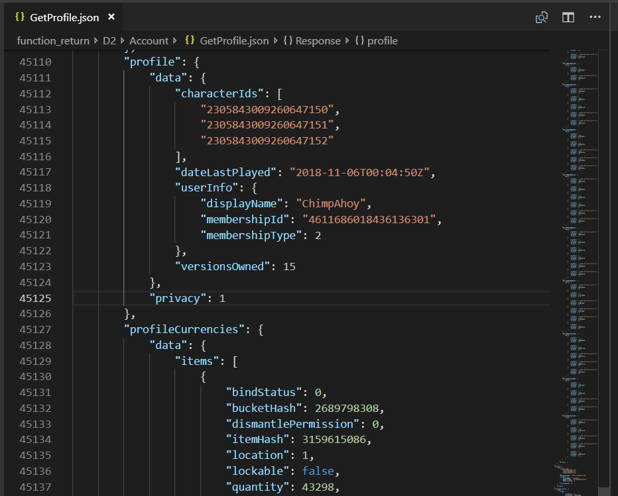
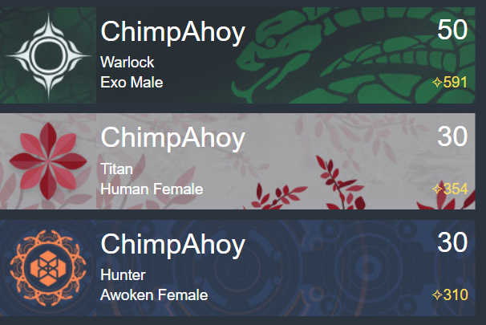
Displaying character information:
JSON response from Bungie:
React output:
Notes:
Here’s the before and after:
The JSON response from the GetProfile request is 50 thousand lines.
In this case, I have 3 characters – this is the maximum you can have.
I parse the response and create the 3 character plates.
Character name.
Character level.
Power level.
Race, gender and class.
Image is made up of 2 images, URL is contained in the JSON response.

Slide 25
Adding React root to your app:
react.html
{% extends "base.html" %} {% block page_content %} <div id="display-emblem"> <div class="loading-icon"></div> </div> {% endblock %}
index.js
import React from 'react'; import ReactDOM from 'react-dom'; import DisplayEmblem from './DisplayEmblem'; ReactDOM.render( <DisplayEmblem />, document.getElementById("display-emblem") );
Notes:
React.html is a Flask Jinja2 HTML template file.
By extending the base.html template, I am adding the navbar and footer.
The contents of the display-emblem div will be replaced with the output of our React component.
The div with the class loading-icon can contain an animated loading icon – this will be replaced when the React component loads.
I am replacing the contents of “display-emblem” with the output of the DisplayEmblem component.

Slide 26
DisplayEmblem.js
import React, { Component } from 'react'; import ReactDOM from 'react-dom'; class DisplayEmblem extends Component { constructor(){ super() this.state = { json_response: [] }; } componentDidMount() { fetch('/character_details', { method: 'POST', mode: 'no-cors', async: 'false', dataType: 'json' }) .then(r => r.json()) .then(r => { this.setState({json_response: r}) }) .catch(err => { this.setState({json_response: "Error!"}) }) } render(){ } } export default DisplayEmblem;
return this.state.json_response.map((item, index) => { return( <div className="emblem-image" key={index}> <div className="emblem" style={{backgroundImage: 'url(https://www.bungie.net/' + item.emblemPath + ')'}}></div> <div className="character-details"> <span className="displayName">{item.displayName}</span> <span className="className">{item.class_name}</span> <span className="raceGender">{item.race_name} {item.gender_name}</span> <span className="level">{item.baseCharacterLevel}</span> <span className="powerLevel light">{item.light}</span> </div> </div> ); });
Notes:
componentDidMount is the preferred way to fetch the data from our API endpoint.
“If you need to load data from a remote endpoint, this is a good place to instantiate the network request.”
We store the JSON response in the DisplayElement state, as this.state.json_response.
We can then use the json_response element from state in the render function.
In the render function I am creating the div, span and image elements you saw on the previous slide.
(first render is instead of defining a var)
This is something I’m still working on – and I haven’t fully transferred to a React frontend.

Slide 27
Adding jQuery to your project:
If you’re using Bootstrap or Moment, you’ve already included jQuery.
It’s very easy to get started.
Works well with server rendered web pages.
base.html
{% block scripts %} {{ super() }} {{ moment.include_moment() }} {% endblock %}
index.html
Notes:
In the case of React, it’s pretty all-or-nothing.
It want’s to handle all of the front end or you need to add some more glue logic to integrate your server rendered page.
jQuery on the other hand is great for server rendered pages.

Slide 28
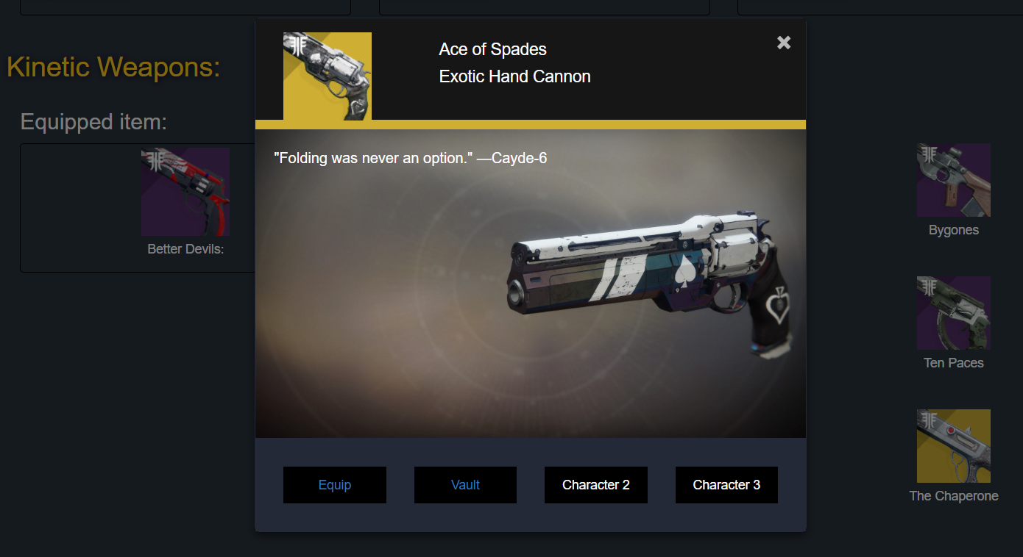
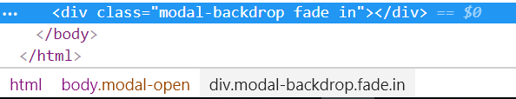
jQuery Modal:
jQuery makes it easy to interact with server rendered HTML.
Notes:
HTML is fully rendered on the server.
Bootstrap modal is included at the bottom of base.html.
jQuery populates modal on click of image.
All modal data is stored in custom html tags of the image.
Item name.
Item type – hand cannon.
Item tier – exotic.
Item description.
Item image.
Item screenshot.
Equip button.
Transfer to vault.

Slide 29
Creating the Modal:
Bootstrap modal:
jQuery:
<!-- Modal: --> <div class="modal fade" id="item" aria-labelledby="exampleModalLabel" aria-hidden="true"> <div class="modal-dialog" role="document"> <div class="modal-content"> <!—Modal header: --> <div class="modal-header"></div> <!—Modal body: --> <div class="modal-body" id="modal-body"></div> <!—Modal footer: --> <div class="modal-footer"> <div class="col-sm-3 transfer-buttons" id="modal-footer-equip-button">Equip</div> </div> </div> </div> </div>
$(document).ready( () =>{ $('.image-modal').on('click', (event) => { // Set variables: var $id = event.currentTarget.id; var $icon = $('#' + $id).attr('src'); var $item_name = $('#' + $id).attr('title'); // Remove any previous modal items: $('#modal-header-image').remove(); // Populate modal header, body and footer: // Header $('#modal-header-image-container').prepend($('<img>', {id:'modal-header-image', style:'max-width: 100%;', src: $icon})); $('#modal-header-item-name').html($item_name); // Show modal: $('.modal').modal('show'); }); });
Notes:
Bootstrap modal is a generic modal, nothing special here yet.
When the document is ready.
When the item with class “image-modal” is clicked.
Get the ID.
Strip out the icon and item_name.
Clear any old information from the modal – the modal div is reused every time an image is clicked.
Add the modal header, body and footer.

Slide 30
Hiding data in HTML attributes:
<img class="img-responsive med-tile image-modal" id="{{ dict_item['itemReferenceHash'] }}" src="{{ dict_item['icon'] }}" title="{{ dict_item['itemName'] }}" tierTypeName="{{ dict_item['tierTypeName'] }}" itemTypeName="{{ dict_item['itemTypeName'] }}" tier="{{ dict_item['tier'] }}" bucket="{{ dict_item['bucket'] }}" itemLightLevel="{{ dict_item['itemLightLevel'] }}" itemReferenceHash="{{ dict_item['itemReferenceHash'] }}" screenshot="{{ dict_item['screenshot'] }}" description="{{ dict_item['description'] }}" equip="equipView/{{ charId }}/{{ dict_item['itemReferenceHash'] }}/.charInventory" vault="transferItem/{{ charId }}/{{ dict_item['itemReferenceHash'] }}/{{ dict_item['itemHash'] }}/{{ True }}/.charInventory" >
<img class="img-responsive small-tile image-modal" onclick="" id="6917529081197372324" src="https://www.bungie.net//common/destiny2_content/icons/29c46cd83dec7bd9363d1a6731a6ee17.jpg" title="Ace of Spades" tiertypename="Exotic" itemtypename="Hand Cannon" tier="" bucket="Kinetic Weapons" itemlightlevel="" itemreferencehash="6917529081197372324" screenshot="/common/destiny2_content/screenshots/347366834.jpg" description="&quot;Folding was never an option.&quot; —Cayde-6" equip="equipView/2305843009260647150/6917529081197372324/.charInventory" vault="transferItem/2305843009260647150/6917529081197372324/347366834/True/.charInventory" >
Notes:
This data can also be contained in HTML meta tags.
I add this data to the images when I render the HTML on the server side.
ID is the specific ID of that item.
The Equip and Vault attributes are used to send post requests.

Slide 31
Questions?
Get in touch:
  Allyn Hunt
  Blog: AllynH.com
  Twitter: @Allyn_H_
  Web application: DestinyVaultRaider.com
  GitHub: https://github.com/AllynH

