Slide 1
Adding data visualization to your Flask app with React Victory charts
Allyn Hunt

Slide 2
Allyn Hunt
Father | Gamer | Maker | Engineer
AllynH.com | @Allyn_H_ | GitHub.com/AllynH

Slide 3
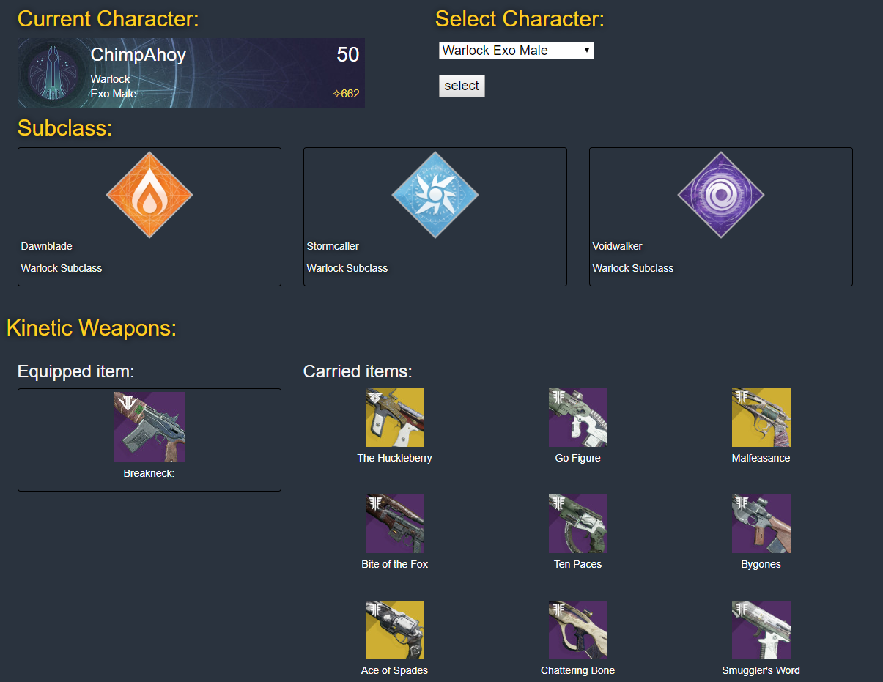
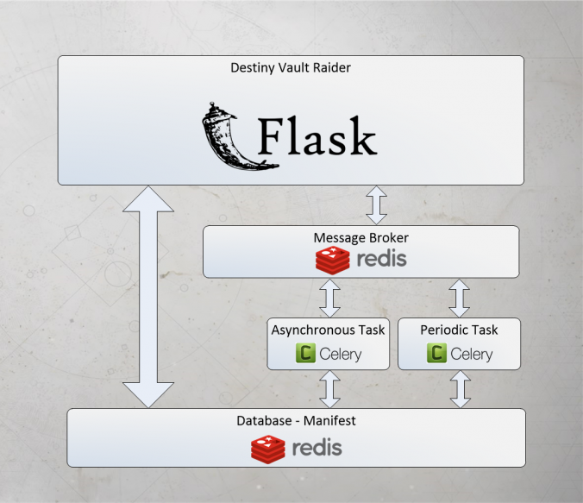
Previous work
PyCon UK 2017:
Destiny Vault Raider app
PyCon Ireland 2018:
Python, Flask, Celery and React.

Slide 4
Flask application
1
Project setup, storing data, creating app Blueprints.

Slide 5
Technology stack:
Server side:
Python 3.6+
Flask
SQL Alchemy
App structure:
Cloned from Miguel Grinbergs microblog app code.
Flask Large app structure.
Blueprints
Frontend:
NPM
ReactJS
React Victory Charts
WebPack
Bable

Slide 6
Web applications are fun!
| config.py | microblog.py | +---app | cli.py | models.py | __init__.py | +---api_1_0 | routes.py | __init__.py | +---main | forms.py | routes.py | __init__.py | +---static | loading.gif | +---templates | base.html | index.html | user.html | \---errors 404.html 500.html
Database definition
from flask import Flask
app = Flask(__name__)
@app.route('/')
def hello_world():
return 'Hello, World!'
Database models
API route and config
React frontend

Slide 7
Displaying data can be tough
{
"BUSINESS_TYPE": "Manufacturing",
"COMPANY": "Stark Industries",
"COMPANY_CEO": "Pepper Potts",
"FINANCE": [
{
"Q1_EARNINGS": 7825000000.0,
"Q2_EARNINGS": 7825000000.0,
"Q3_EARNINGS": 7825000000.0,
"Q4_EARNINGS": 7825000000.0,
"YEAR": 2018
},
{
"Q1_EARNINGS": 7825000000.0,
"Q2_EARNINGS": 7825000000.0,
"Q3_EARNINGS": 7825000000.0,
"Q4_EARNINGS": 7825000000.0,
"YEAR": 2017
},
{
"Q1_EARNINGS": 7825000000.0,
"Q2_EARNINGS": 7825000000.0,
"Q3_EARNINGS": 7825000000.0,
"Q4_EARNINGS": 7825000000.0,
"YEAR": 2016
},
{
"Q1_EARNINGS": 7825000000.0,
"Q2_EARNINGS": 7825000000.0,
"Q3_EARNINGS": 7825000000.0,
"Q4_EARNINGS": 7825000000.0,
"YEAR": 2015
}
]
}
Getting data into your database is easy:
Build multiple tables.
Complex relationships.
How do you display this data?:
Dates / Times
Dictionaries
Lists

Slide 8
{
"BUSINESS_TYPE": "Manufacturing",
"COMPANY": "Stark Industries",
"COMPANY_CEO": "Pepper Potts",
"FINANCE": [
{
"Q1_EARNINGS": 7825000000.0,
"Q2_EARNINGS": 7825000000.0,
"Q3_EARNINGS": 7825000000.0,
"Q4_EARNINGS": 7825000000.0,
"YEAR": 2018
},
{
"Q1_EARNINGS": 7825000000.0,
"Q2_EARNINGS": 7825000000.0,
"Q3_EARNINGS": 7825000000.0,
"Q4_EARNINGS": 7825000000.0,
"YEAR": 2017
},
{
"Q1_EARNINGS": 7825000000.0,
"Q2_EARNINGS": 7825000000.0,
"Q3_EARNINGS": 7825000000.0,
"Q4_EARNINGS": 7825000000.0,
"YEAR": 2016
},
{
"Q1_EARNINGS": 7825000000.0,
"Q2_EARNINGS": 7825000000.0,
"Q3_EARNINGS": 7825000000.0,
"Q4_EARNINGS": 7825000000.0,
"YEAR": 2015
}
]
}
{
"DATA": [
{
"BUSINESS_TYPE": "Manufacturing",
"COMPANY": "Stark Industries",
"COMPANY_CEO": "Pepper Potts",
"FINANCE": […
]
},
{
"BUSINESS_TYPE": "Multinational Conglomerate",
"COMPANY": "WayneCorp",
"COMPANY_CEO": "Bruce Wayne",
"FINANCE": [ …
]
}
]
}

Slide 9
How I feel

Slide 10
What my boss sees

Slide 11
{
"BUSINESS_TYPE": "Manufacturing",
"COMPANY": "Stark Industries",
"COMPANY_CEO": "Pepper Potts",
"FINANCE": [
{
"Q1_EARNINGS": 7825000000.0,
"Q2_EARNINGS": 7825000000.0,
"Q3_EARNINGS": 7825000000.0,
"Q4_EARNINGS": 7825000000.0,
"YEAR": 2018
},
{
"Q1_EARNINGS": 7825000000.0,
"Q2_EARNINGS": 7825000000.0,
"Q3_EARNINGS": 7825000000.0,
"Q4_EARNINGS": 7825000000.0,
"YEAR": 2017
},
{
"Q1_EARNINGS": 7825000000.0,
"Q2_EARNINGS": 7825000000.0,
"Q3_EARNINGS": 7825000000.0,
"Q4_EARNINGS": 7825000000.0,
"YEAR": 2016
},
{
"Q1_EARNINGS": 7825000000.0,
"Q2_EARNINGS": 7825000000.0,
"Q3_EARNINGS": 7825000000.0,
"Q4_EARNINGS": 7825000000.0,
"YEAR": 2015
}
]
}
Company
Name
CEO name
Business type
Finance
Finance
Finance
Q1 earnings
Q2 earnings
Q3 earnings
Q4 earnings
Q1 earnings
Q2 earnings
Q3 earnings
Q4 earnings
Q1 earnings
Q2 earnings
Q3 earnings
Q4 earnings

Slide 12
Add Finance item to database
Database model
class Finance(db.Model):
__tablename__ = 'finance'
id = db.Column(db.Integer, primary_key=True)
year = db.Column(db.Integer, default=1999)
q1_earnings = db.Column(db.Float)
q2_earnings = db.Column(db.Float)
q3_earnings = db.Column(db.Float)
q4_earnings = db.Column(db.Float)
company_id = db.Column(db.Integer, db.ForeignKey('company.id'))
def __repr__(self):
return '<Finance {}>'.format(self.id)
stark_finance_y1 = Finance(
year = stark_finance_y1["YEAR"],
q1_earnings = stark_finance_y1["Q1_EARNINGS"],
q2_earnings = stark_finance_y1["Q2_EARNINGS"],
q3_earnings = stark_finance_y1["Q3_EARNINGS"],
q4_earnings = stark_finance_y1["Q4_EARNINGS"]
)
:
stark_finance_y4 = Finance(
year = stark_finance_y4["YEAR"],
q1_earnings = stark_finance_y4["Q1_EARNINGS"],
q2_earnings = stark_finance_y4["Q2_EARNINGS"],
q3_earnings = stark_finance_y4["Q3_EARNINGS"],
q4_earnings = stark_finance_y4["Q4_EARNINGS"]
)
finance_list = [stark_finance_y1, stark_finance_y2, stark_finance_y3, stark_finance_y4]
List of Finance objects

Slide 13
Add Company item to database
Database model
class Company(db.Model):
__tablename__ = 'company'
id = db.Column(db.Integer, primary_key=True)
name = db.Column(db.String(140))
company_ceo = db.Column(db.String(140))
business_type = db.Column(db.String(140))
finances = db.relationship('Finance', backref='finance', lazy='dynamic')
def __repr__(self):
return '<Company {}>'.format(self.name)
Add item to database
my_stark_company = Company(
name = stark_company["COMPANY"],
company_ceo = stark_company["COMPANY_CEO"],
business_type = stark_company["BUSINESS_TYPE"],
finances = finance_list
)
db.session.add(my_stark_company)
db.session.commit()

Slide 14
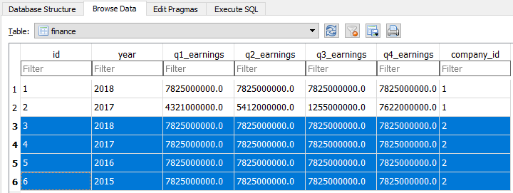
Viewing our SQL data

Slide 15
Create relationships
Add item to database
my_company = Company(
name = company_waynecorp["COMPANY"],
company_ceo = company_waynecorp["COMPANY_CEO"],
business_type = company_waynecorp["BUSINESS_TYPE"]
)
db.session.add(my_company)
company1_finance_y1 = Finance(
year = wayne_finance_y1["YEAR"],
q1_earnings = wayne_finance_y1["Q1_EARNINGS"],
q2_earnings = wayne_finance_y1["Q2_EARNINGS"],
q3_earnings = wayne_finance_y1["Q3_EARNINGS"],
q4_earnings = wayne_finance_y1["Q4_EARNINGS"]
)
company1_finance_y2 = Finance(
year = wayne_finance_y2["YEAR"],
q1_earnings = wayne_finance_y2["Q1_EARNINGS"],
q2_earnings = wayne_finance_y2["Q2_EARNINGS"],
q3_earnings = wayne_finance_y2["Q3_EARNINGS"],
q4_earnings = wayne_finance_y2["Q4_EARNINGS"]
)
my_company.finances.append(company1_finance_y1)
my_company.finances.append(company1_finance_y2)
Create database relationships

Slide 16
Flask Blueprints
App.py
Unauthorized endpoints
Request
Authorized endpoints
Response
API endpoints

Slide 17
Creating an API endpoint to send JSON data.
app/api_1_0/__init__.py
app/api_1_0/routes.py
from flask import Blueprint
bp = Blueprint('api', __name__)
from app.api_1_0 import routes
@bp.route('/get_company/<int:id>')
@login_required
def get_company(id):
c = Company.query.filter_by(id=id).first_or_404()
message = "Welcome to the API :)"
content = {
"name" : c.name,
"ceo_name" : c.company_ceo,
"business type" : c.business_type
}
status_dict = {
"status": 200,
"success": True,
"message": message,
"contentType":'application/json',
"content": content
}
return jsonify(status_dict), status_dict["status"]
app/__init__.py
def create_app(config_class=Config):
app = Flask(__name__)
# Rest of your config goes here:
from app.api_1_0 import bp as api_bp
app.register_blueprint(api_bp, url_prefix='/api_1_0')

Slide 18
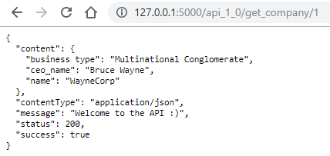
Testing the endpoint:
Chrome will display the JSON response
Values are now coming from our database

Slide 19
What have we done so far?
Serve HTML / Data

Slide 20
Adding a React frontend
2
Install Webpack, Babel, React, make some API calls from React.

Slide 21
Why do we need JavaScript?
/login_user
Navigation | Login
Chart 1
Chart 2
/get_chart_1/<id>
/get_test_results/<id>
Page content
/get_content/<user_id>

Slide 22
Inportant files
│ package-lock.json │ package.json │ webpack.config.js │ ├───css │ style.css │ ├───dist │ bundle.js │ └───scripts index.js Finance.js HelloWorld.js
Webpack / Babel config
Webpack / Babel output code
React code

Slide 23
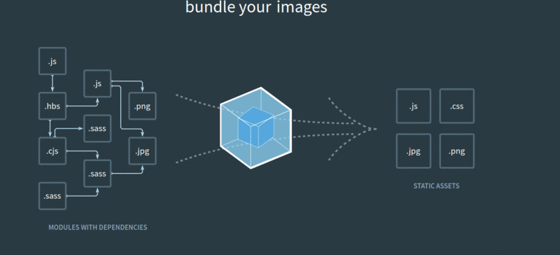
Webpack

Slide 24
Setting up Web Pack
Initialise your project:
Install Web Pack
Install Web Pack CLI
npm init:
Creates package.json
webpack.config.js:
Project configuration
npm init
npm i webpack --save-dev
npm i webpack-cli --save-dev
See examples in repo

Slide 25
Babel

Slide 26
Setting up Babel
Install Babel
npm i \ @babel/core \ babel-loader \ @babel/preset-env \ @babel/preset-react \ --save-dev

Slide 27
Installing React and Victory
Install React & React DOM.
Install Victory Chart library.
npm i react react-dom [--save-dev]
npm install victory --save-dev

Slide 28
Setting up Webpack scripts
{
"name": "flask-data-visualization",
"version": "1.0.0",
"description": "Example Flask application with React frontend. This app uses Victory Charts to display data visualization examples.",
"main": "index.js",
"scripts": {
"build": "webpack -p --progress --config webpack.config.js",
"dev-build": "webpack --progress -d --config webpack.config.js",
"watch": "webpack --progress -d --config webpack.config.js --watch"
},
"repository": {
"type": "git",
"url": "git+https://github.com/AllynH/flask-data-visualization.git"
},
"keywords": [
"Flask", "React", "ReactJS", "Victory", "Python", "Javascript"
],
"author": "Allyn Hunt",
"babel": {
"presets": [
"@babel/preset-env",
"@babel/preset-react"
]
},
"license": "MIT",
"homepage": "https://github.com/AllynH/flask-data-visualization#readme",
"devDependencies": {
"@babel/core": "^7.6.3",
"@babel/preset-env": "^7.6.3",
"@babel/preset-react": "^7.6.3",
"babel-loader": "^8.0.6",
"victory": "^33.1.1",
"webpack": "^4.41.0",
"webpack-cli": "^3.3.9"
"react": "^16.9.0",
"react-dom": "^16.9.0"
}
}
"scripts": {
"build": "webpack -p --progress --config webpack.config.js",
"dev-build": "webpack --progress -d --config webpack.config.js",
"watch": "webpack --progress -d --config webpack.config.js --watch"
},

Slide 29
const webpack = require('webpack');
const config = {
entry: __dirname + '/scripts/index.js',
output: {
path: __dirname + '/dist',
filename: 'bundle.js',
},
resolve: {
extensions: ['.js', '.jsx', '.css']
},
module: {
rules: [
{
test: /\.(js|jsx)?/,
exclude: /node_modules/,
use: 'babel-loader'
},
{
test: /\.(png|svg|jpg|gif)$/,
use: 'file-loader'
}
]
}
};
module.exports = config;
Entry file:
/scripts/index.js
bundle.js
In /dist folder
For .js / .jsx files
Use babel-loader

Slide 30
> webpack --help webpack-cli 3.3.9 Usage: webpack-cli [options] webpack-cli [options] --entry <entry> --output <output> webpack-cli [options] <entries...> --output <output> webpack-cli <command> [options] For more information, see https://webpack.js.org/api/cli/. Config options: --config Path to the config file [string] [default: webpack.config.js or webpackfile.js] --config-register, -r Preload one or more modules before loading the webpack configuration [array] [default: module id or path] --config-name Name of the config to use [string] --env Environment passed to the config, when it is a function --mode Enable production optimizations or development hints. [choices: "development", "production", "none"] Basic options: --context The base directory (absolute path!) for resolving the `entry` option. If `output.pathinfo` is set, the included pathinfo is shortened to this directory. [string] [default: The current directory] --entry The entry point(s) of the compilation. [string] --watch, -w Enter watch mode, which rebuilds on file change. [boolean] --debug Switch loaders to debug mode [boolean] --devtool A developer tool to enhance debugging. [string] -d shortcut for --debug --devtool eval-cheap-module-source-map --output-pathinfo [boolean] -p shortcut for --optimize-minimize --define process.env.NODE_ENV="production" [boolean] --progress Print compilation progress in percentage [boolean]

Slide 31
React – Hello, World!
app/static/scripts/HelloWorld.js
import React from 'react';
class HelloWorld extends React.Component {
render() {
return (
<h1>Hello, World!</h1>
);
}}
export default HelloWorld;
Create the component
Attach the component to the DOM
app/static/scripts/index.js
import React from "react";
import ReactDOM from "react-dom";
import HelloWorld from "./HelloWorld";
ReactDOM.render(<HelloWorld />, document.getElementById("react-root"));

Slide 32
Adding React to your Flask app
Create the “react-root” div.
Add the JavaScript.
Static folder.
Filename is bundle.js
Script can be added:
to individual templates
or to base.html
{% block app_content %}
<div id="react-root"></div>
<script src="{{ url_for('static', filename='dist/bundle.js') }}"></script>
{% endblock %}

Slide 33
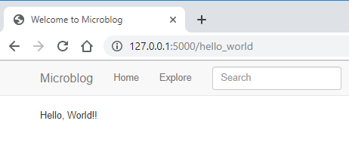
Viewing your React app
Not much here yet…
But it’s working!

Slide 34
Fetching API data from your React frontend
class Finance extends React.Component {
constructor(props) {
super(props);
this.state = {
error: null,
isLoaded: false,
items: []
};
}
componentDidMount() {
fetch("/api_1_0/finance/1/2018")
.then(res => res.json())
.then(
(result) => {
this.setState({
isLoaded: true,
items: result.items
});
}, (error) => {
this.setState({
isLoaded: true,
error
});
}
)
}
render() {
const { error, isLoaded, items } = this.state;
if (error) {
return <div>Error: {error.message}</div>;
} else if (!isLoaded) {
return <div>Loading...</div>;
} else {
return ( );
}
}
}
Added constructor():
Stores our state
class Finance extends React.Component {
render() {
return (
<div>Hello, World!</div>
);
}
}
componentDidMount():
Makes API call
Updated render():
Handles error, loading or loaded state

Slide 35
URL parameters
let url = window.location.href.replace(/.*finance/).split("/");
const company_id = url[1];
const year = url[2];
const api_url = "/api_1_0/get_finances/" + company_id + "/" + year;
HTML URL: http://127.0.0.1:5000/finance/1/2018
API URL: http://127.0.0.1:5000/api_1_0/get_finances/1/2018

Slide 36
What have we done so far?
Serve HTML / Data
Make API call with React

Slide 37
Victory Charts
3
Make a basic chart, look at how to create some really cool charts.

Slide 38
VICTORY CHARTS
Formidable Labs

Slide 39
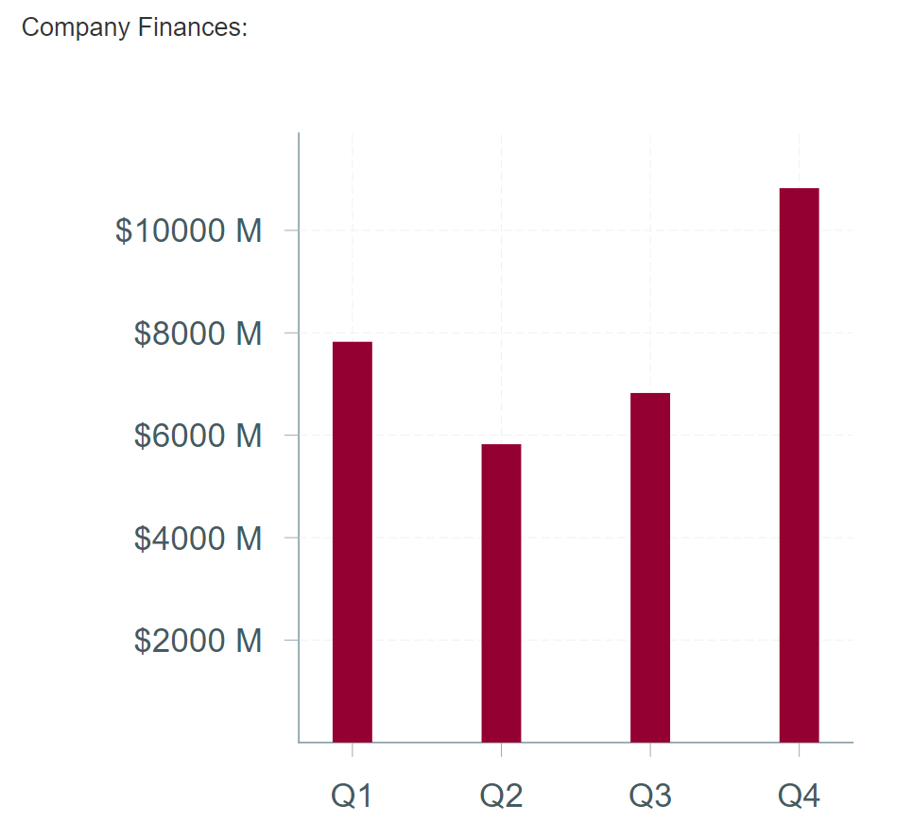
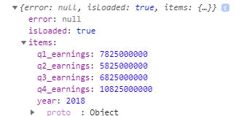
Chart ☺
127.0.0.1 - - [09/Oct/2019 22:05:07] "GET /api_1_0/get_finances/1/2018 HTTP/1.1" 200

Slide 40
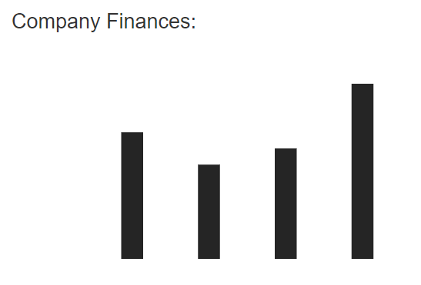
VictoryBar
<VictoryBar
data={finance_data}
/>

Slide 41
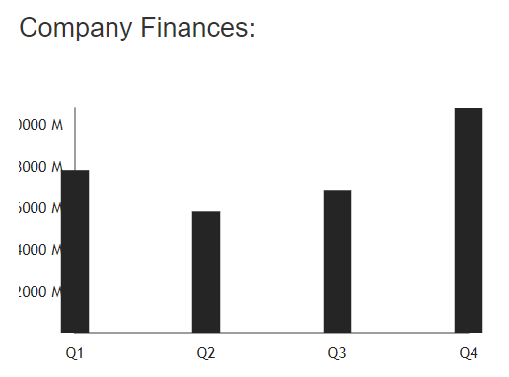
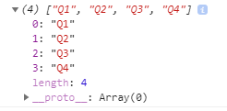
Victory Chart
<VictoryChart
>
<VictoryAxis tickValues={finance_axis} />
<VictoryAxis dependentAxis tickFormat={x => `$${x/1000000} M`} />
<VictoryBar
data={finance_data}
/>
</VictoryChart>

Slide 42
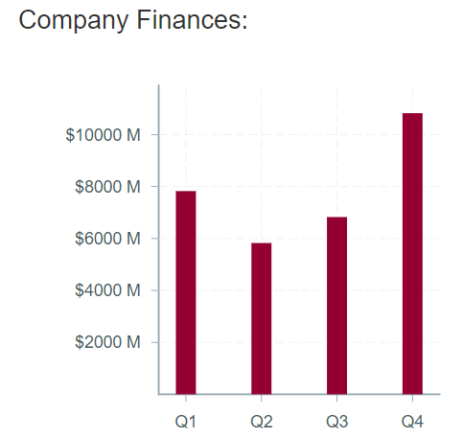
Some style
<VictoryChart
padding={{ left: 100, right: 50, bottom: 100, top: 30 }}
fontSize={8}
domainPadding={20}
theme={VictoryTheme.material}
>
<VictoryAxis tickValues={finance_axis} />
<VictoryAxis dependentAxis tickFormat={x => `$${x/1000000} M`} />
<VictoryStack colorScale={"warm"}>
<VictoryBar
data={finance_data}
/>
</VictoryStack>
</VictoryChart>

Slide 43
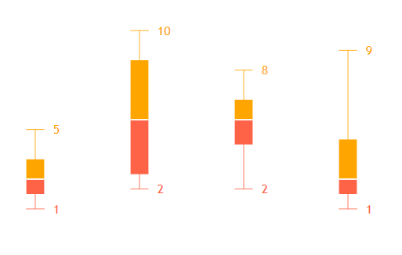
VictoryBoxPlot example
class BoxPlot extends React.Component {
render() {
return (
<div>
<VictoryBoxPlot
minLabels
maxLabels
data={[
{ x: 1, y: [1, 2, 3, 5] },
{ x: 2, y: [3, 2, 8, 10] },
{ x: 3, y: [2, 8, 6, 5] },
{ x: 4, y: [1, 3, 2, 9] }
]}
style={{
min: { stroke: "tomato" },
max: { stroke: "orange" },
q1: { fill: "tomato" },
q3: { fill: "orange" },
median: { stroke: "white", strokeWidth: 2 },
minLabels: { fill: "tomato" },
maxLabels: { fill: "orange" }
}}
/>
</div>
);
}}
export default BoxPlot;

Slide 44
What have we done so far?
Serve HTML / Data
Make API call with React
Render Victory chart

Slide 45
Secure your API
4
Some tips to secure your API and database.

Slide 46
Making secure API requests
app/api_1_0/routes.py
app/api_1_0/routes.py
@bp.route('/get_company/<id>')
@login_required
def get_company(id):
c = Company.query.filter_by(id=id).first_or_404()
message = "Welcome to the API :)"
content = {
"name" : c.name,
"ceo_name" : c.company_ceo,
"business type" : c.business_type
}
status_dict = {
"status": 200,
"success": True,
"message": message,
"contentType":'application/json',
"content": content
}
return jsonify(status_dict), status_dict["status"]
@bp.route('/get_company/<int:id>')
@login_required
def get_company(id):
c = Company.query.filter_by(id=id).first_or_404()
message = "Welcome to the API :)"
content = {
"name" : c.name,
"ceo_name" : c.company_ceo,
"business type" : c.business_type
}
status_dict = {
"status": 200,
"success": True,
"message": message,
"contentType":'application/json',
"content": content
}
return jsonify(status_dict), status_dict["status"]

Slide 47
THANKS!
Any questions?
@Allyn_H_ / AllynH@gmail.com
GitHub.com/AllynH

